Slide 1

IMS Starter project
Charles HErrIott
Notes:
Hi, my name is Charlie Herriott. This is my IMS project presentation.

Slide 2
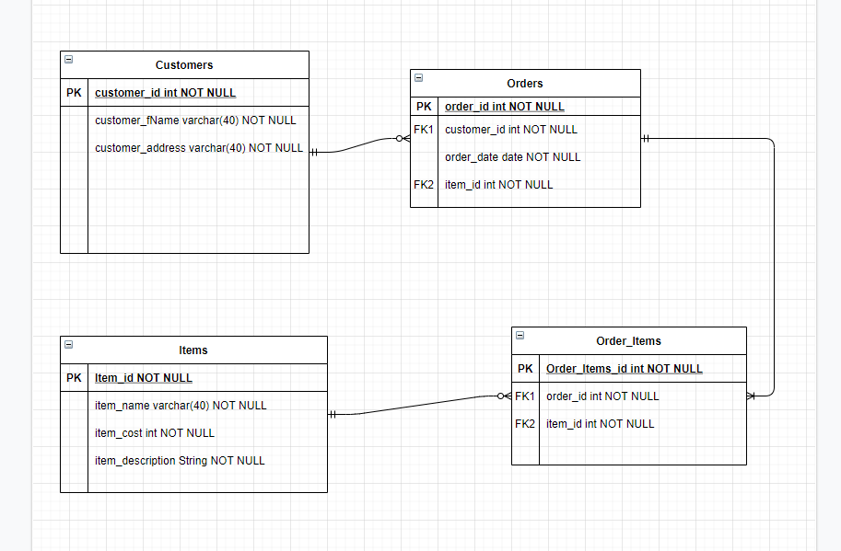
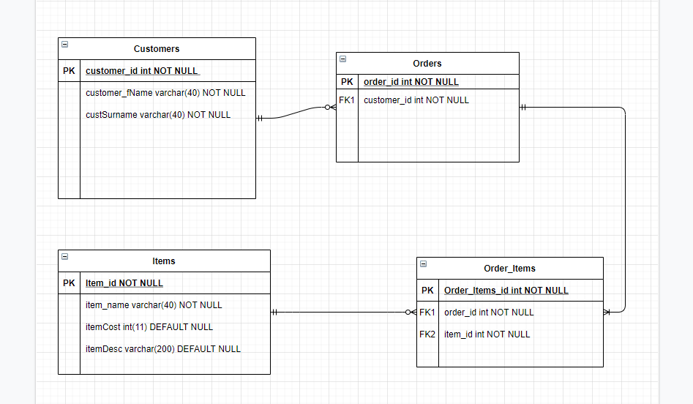
Introduction
My approach:
My first step was to create an ERD diagram to describe what I expected the relationships between the database tables to be.

Slide 3
I considered the structure in which I would approach the project. This meant including Jira and GitHub in my work approach. I adhered to this flow:
I create a user story which describes the end goal and reason behind it
I implemented functionality to complete this task
I then committed the implementation through a feature branch into my GitHub repository

Slide 4
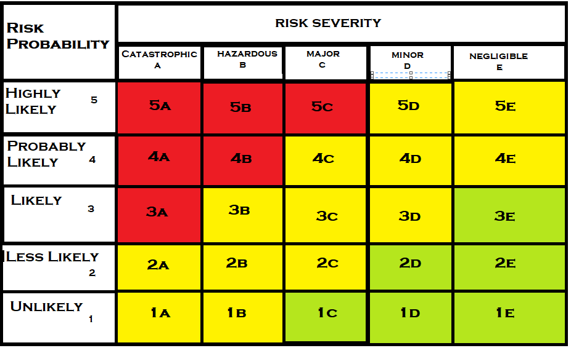
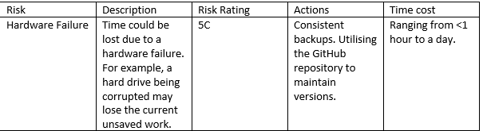
Risk Assessment
Notes:
This is a brief overview of my risk assessment matrix and one risk that I added.

Slide 5
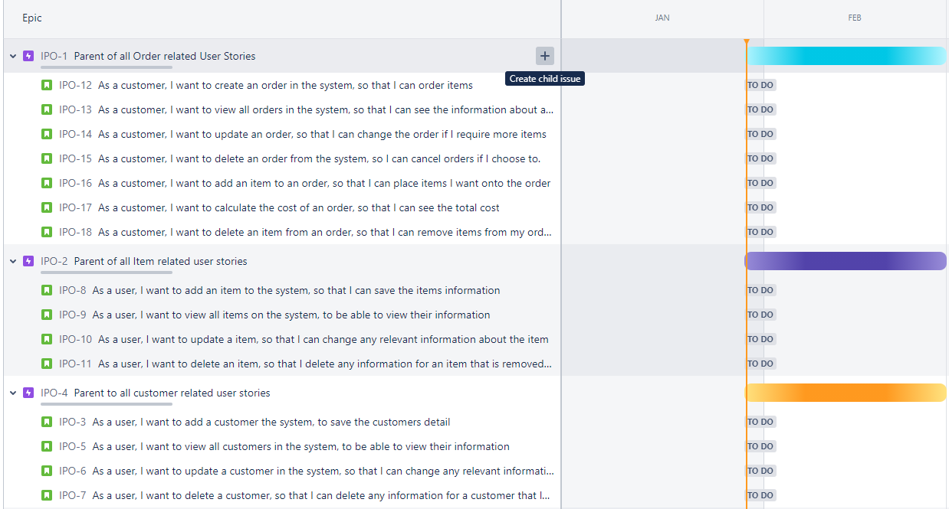
Jira
Jira is made up of Epics, User Stories, Tasks and various values/descriptions that can be applied
Notes:
This is a screenshot of the first draft of my Jira board where I have added user stories to their relevant epics.
This was used to map out the base functionality that I wanted to implement into the program, along with non-code related tasks. For example, creating a risk assessment.

Slide 6
Breaking down the code
My first step was break down the specification into smaller logical steps.
For example, ‘Add a Item to the system’. I took this requirement and broke it down into the steps that I would take to accomplish this task.
I would need to be able to: create an object in Java, pass that object through an SQL query, add it to the database and then read the row back from the database, including the primary key.
Notes:
When I was considering how to approach developing the code for a requirement, I broke each task down into smaller tasks, figuring out how the logical flow would work.
So, back to the Add Item example. The first thing that I need to be able to do is take in a user input.
After capturing the input, this was passed through the ItemController create function.
Which was then passed through to the ItemDAO, which executed the relevant SQL query.
Which then returned a created Item Object with the respective values applied.

Slide 7
Consultant journey
Technologies:
Eclipse/ Java
Jira
GitHub
SonarQube
Junit
Mockito
SQL
Research
Notes:
Over the next few slides I am going to cover the technologies that I have learnt over previous weeks, and how I used them within the scope of my project.

Slide 8
Eclipse / JAva
Eclipse is an integrated development environment used in computer programming. It contains a base workspace and an extensible plug-in system for customising the environment.
Notes:
Eclipse has been the heart of this project, where all of my code development and implementation of my project planning has come to life.
Java is the language used to develop this project, and there are many techniques and principles that I have recently learnt that I have applied to the project.

Slide 9
Object oriented programming principles
I have attempted to stick to the OOP principles throughout my project, making understandable, clean and efficient code under this structure.
Encapsulation
Inheritance
Polymorphism
Abstraction
Notes:
The OOP principles are a very powerful tool that can be used, to create elegant and efficient code. They are applied to many languages, including Java. I have attempted to stick to the OOP principles throughout my project, making understandable, clean and efficient code under this structure.

Slide 10
Solid prinicples
S – single responsibility
O – open for extension, closed for modification
L – liskov substitution
I – interface segregation
D – dependency inversion
Notes:
I have attempted to apply SOLID principles throughout the entire development process of this project.
Each class present within my project has singular responsibility.
Each method within each class, is independent and does not rely on any other method, meaning that they could be used within a different class by another developer.
Liskov substation couldn’t really be applied as there is no inheritance in this project, only implementations.

Slide 11

JiRA
Jira is a proprietary issue tracking product developed by Atlassian that allows bug tracking and agile project management.
Notes:
Jira has been an exceptionally powerful tool that has been utilised within this project.
It has helped to map out the development process, how to maintain tasks and priorities.

Slide 12
Jira uses
Jira can be used simply, or in much more detail. For example, a basic user story allows for a brief description of the task.
Jira story points allow for effort-required values to applied to each task.
Jira priority can be used to denote the urgency of the task.
Descriptions can be added to communicate between members of the team, and to highlight issues.
Smart commits when integrated with GitHub
Notes:
I have attempted to utilise the full power of Jira, by applying subtasks, story points, MoSCoW prioritisation, utilising smart commits, creating and completing sprints.

Slide 13
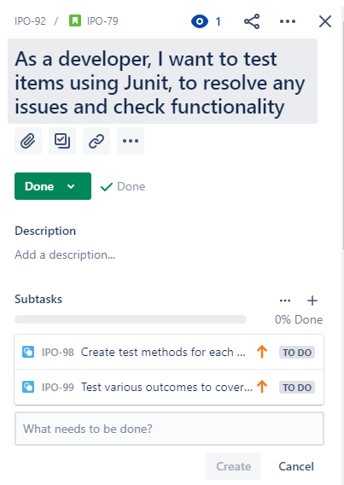
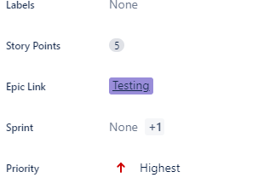
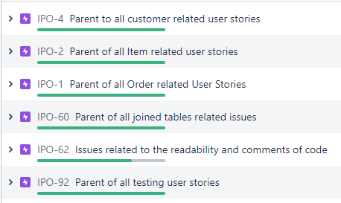
JIRA User stories
Notes:
The screenshot on the left shows the epics I created.
The screenshot on the middle shows the user story with the relevant subtasks.
The screenshot in the right shows the epic link, the story points and the priority

Slide 14

Github
GitHub is a distributed version-control system for tracking changes in any set of files.
Notes:
GitHub has been an integral component to this project, allowing for easily maintainable version control, and files tracking.
I have used GitHub regularly throughout the project, and the entire flow of the project should be visible throughout the commit history graph.

Slide 15
Github uses
GitHub allows for controlled commits of features through GitBash.
This allows for projects to be worked on in tandem with other developers.
New code can be committed and then merge request can be pulled and reviewed before actually being implemented.
The power of version control really shines when a version rollback is needed, and the previous can be simply pulled from GitHub.
Notes:
I have attempted to utilise the full power of GitHub, making commits at the proper time, in the proper feature branches.
This was particularly useful when ensuring that new implementation was compatible with the master code.
GitHub allows for controlled commits of features through GitBash.
This allows for projects to be worked on in tandem with other developers.
The power of version control really shines when a version rollback is needed, and the previous can be simply pulled from GitHub.

Slide 16

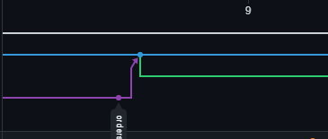
Github commit progression
This was the first commit that I made. Committing some implementation.
w
This commit is from around the middle of the timeline, where I was completing user story tasks and then merging the branches.
First Commit
Commit and then create new branch
Notes:
The first timed I committed, I committed the item feature branch, and then merged that with develop branch.
I then decided I wanted to work more on the item branch so I didn’t delete the branch, and committed and merged again further down the line.
At this time I also created a Jira branch, and I was working on that at the same time.
In the second image, I had finished what I had wanted to do with the orders branch, so I committed and merged. I then created a new branch to work on created some enums to clean up my code.

Slide 17
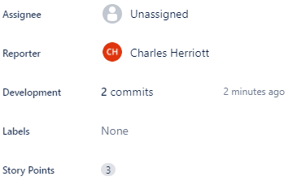
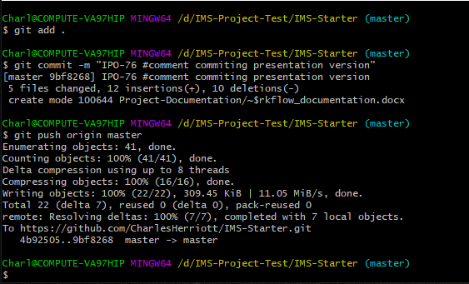
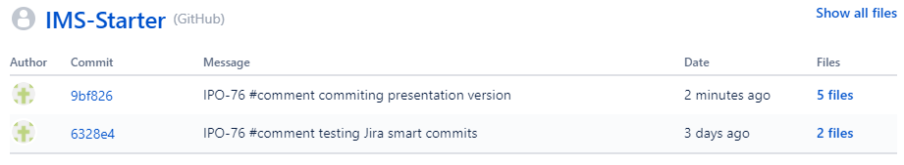
GitHub Smart commits
Notes:
Around the middle of my project I started to utilise smart commits

Slide 18
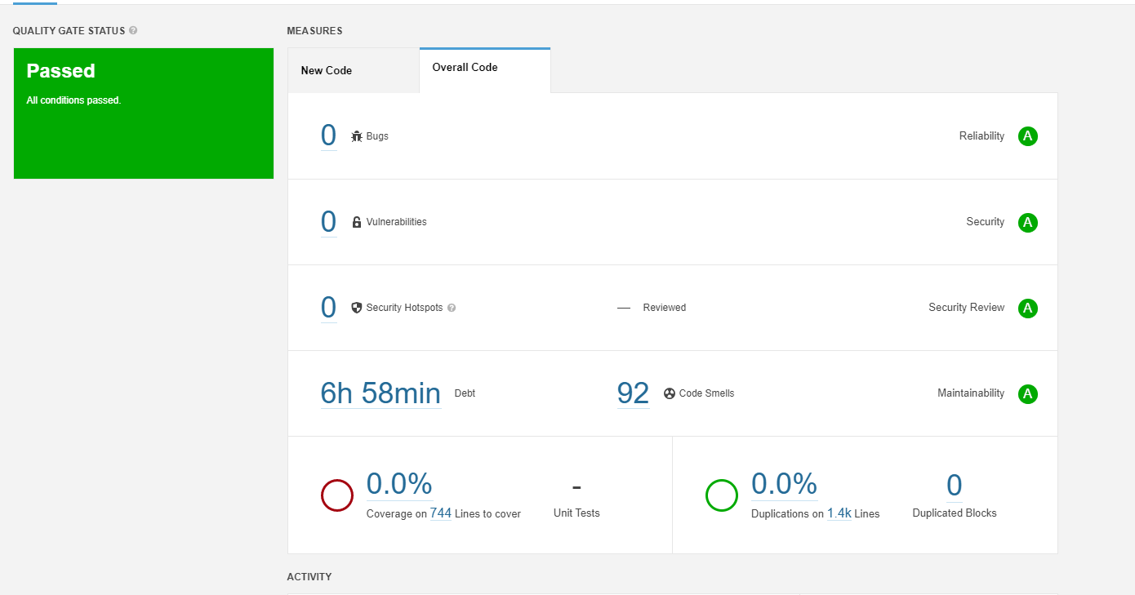
Sonarqube
Notes:
This is the first sonarqube report after uploading my project. Which shows the code smells at 92. This was quite alarming at first, until <<<NEXT SLIDE>>>

Slide 19
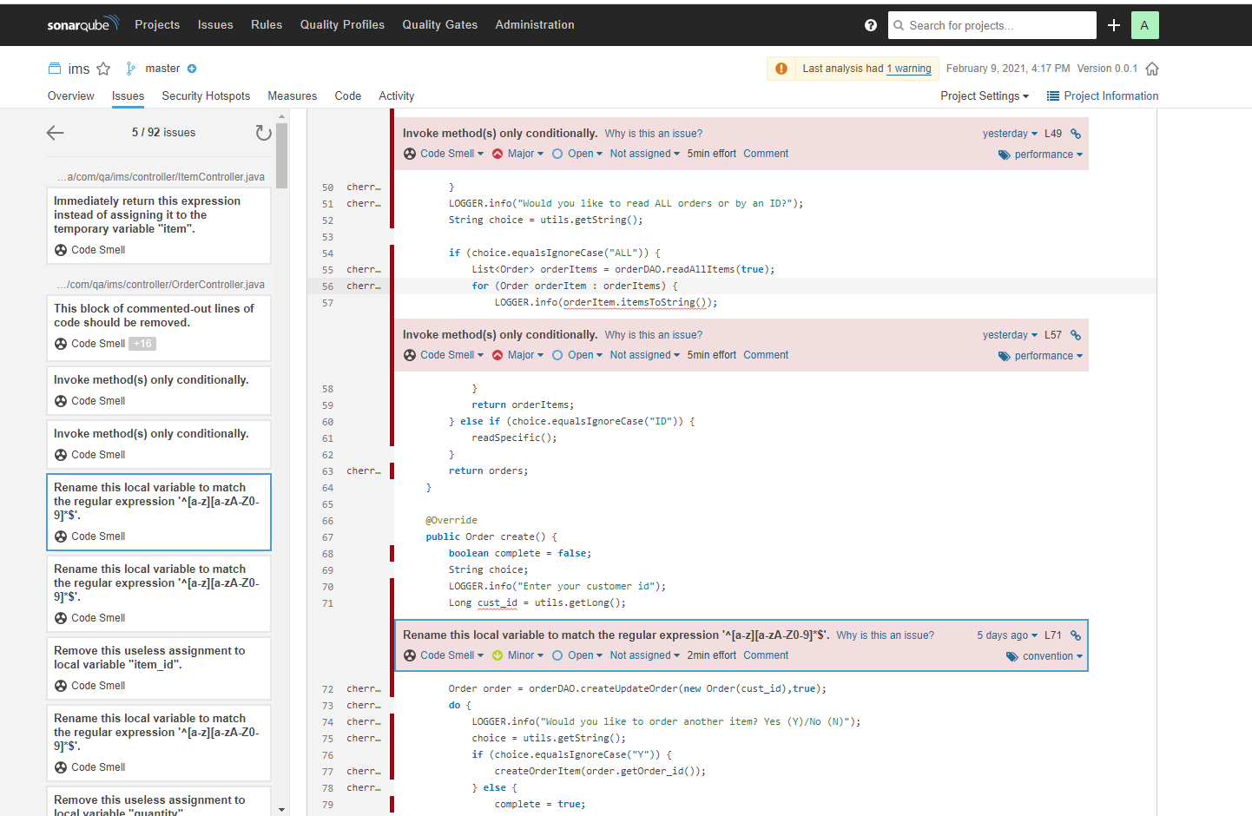
Sonarqube
Notes:
The majority of the code smells were due to naming conventions, where I had used underscores instead of adhering to camelCase.

Slide 20
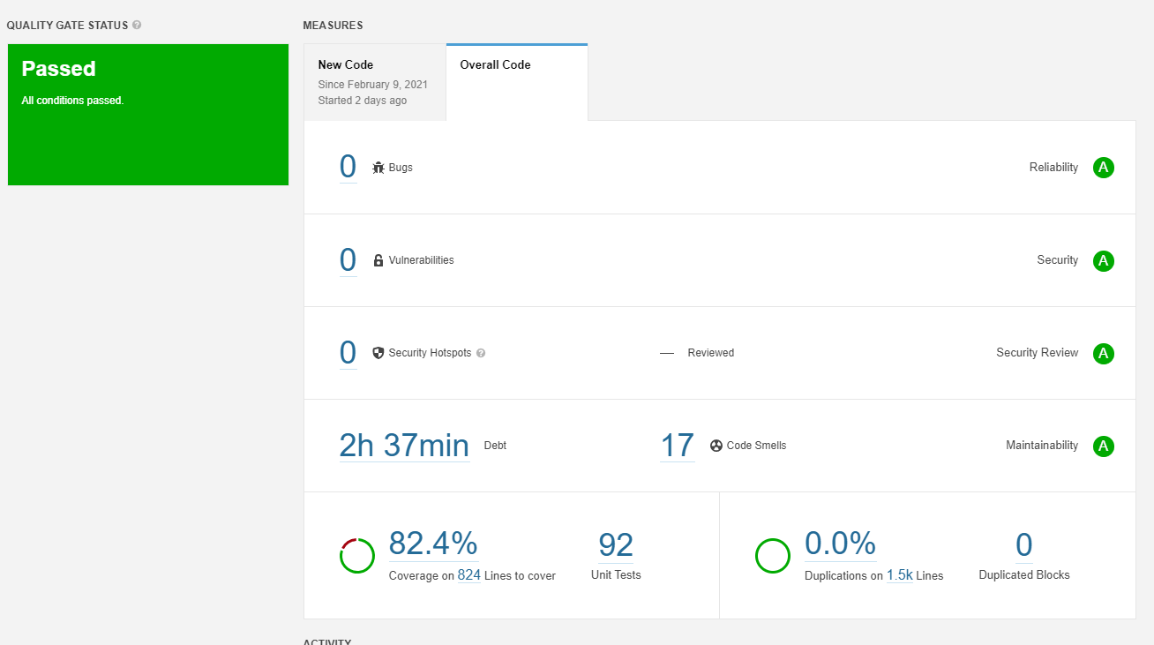
sonarqube
Notes:
After revising the code and editing the naming conventions and a couple of other recommendations, I got the code smells down to 17.

Slide 21
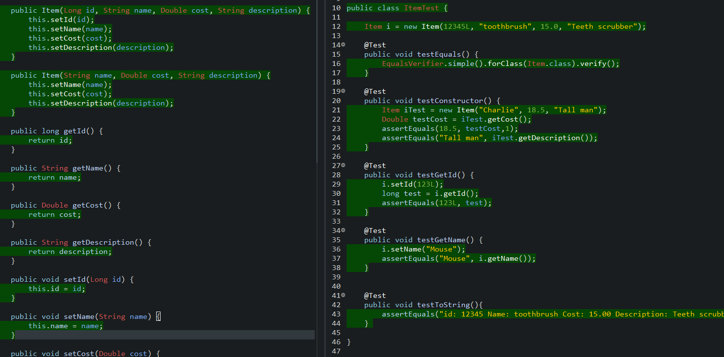
JUnit
Notes:
Junit was used to test on a per-method basis.

Slide 22
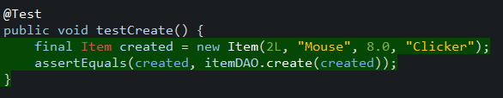
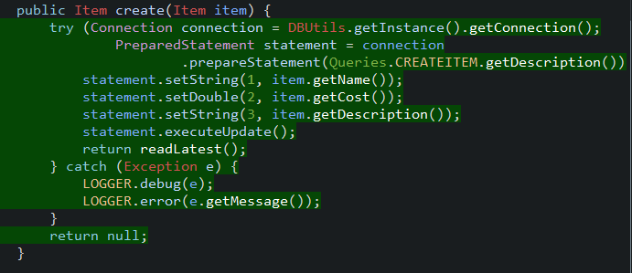
Junit test case
Notes:
This slide shows an individual test of itemDAO create. This works by created an expected object, with set values. It then passed that object through the itemDAO create method and compares the results.

Slide 23
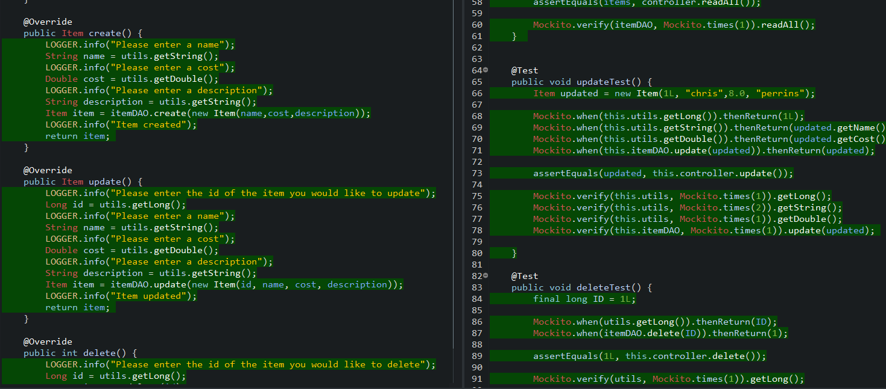
Mockito
Notes:
Mockito is used for integration testing which allows for a group of methods to be tested at the same time. This is done by mocking objects.

Slide 24
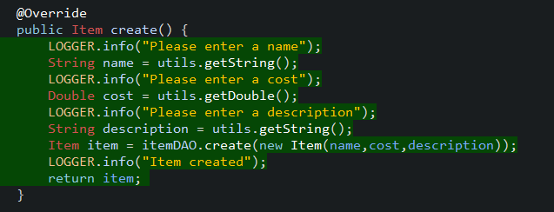
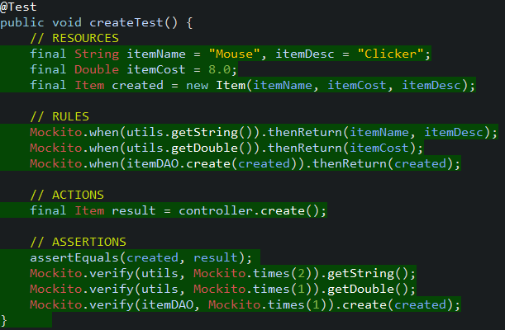
Mockito test case
Notes:
In this case, the create method from item controller is being tested.
The first step is declar and initialize the variables that will be needed.
Then define the rules, for example, when the getString method is called, return the item name and item description
Then define the actions, as the result should equal what the create method returns
Then execute the assertions, where the result is compared to the expected result
And the verify method verifies that a method has been called a specific number of times.

Slide 25
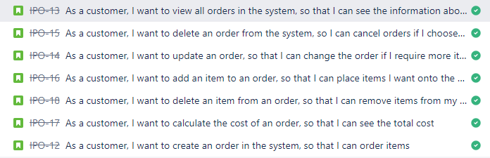
demonstration
A variety of user stories will now be demonstrated through the GitBash console.
Notes:
I am now going to demonstrate the application through gitbash, were I will run through some order related user stories.

Slide 26
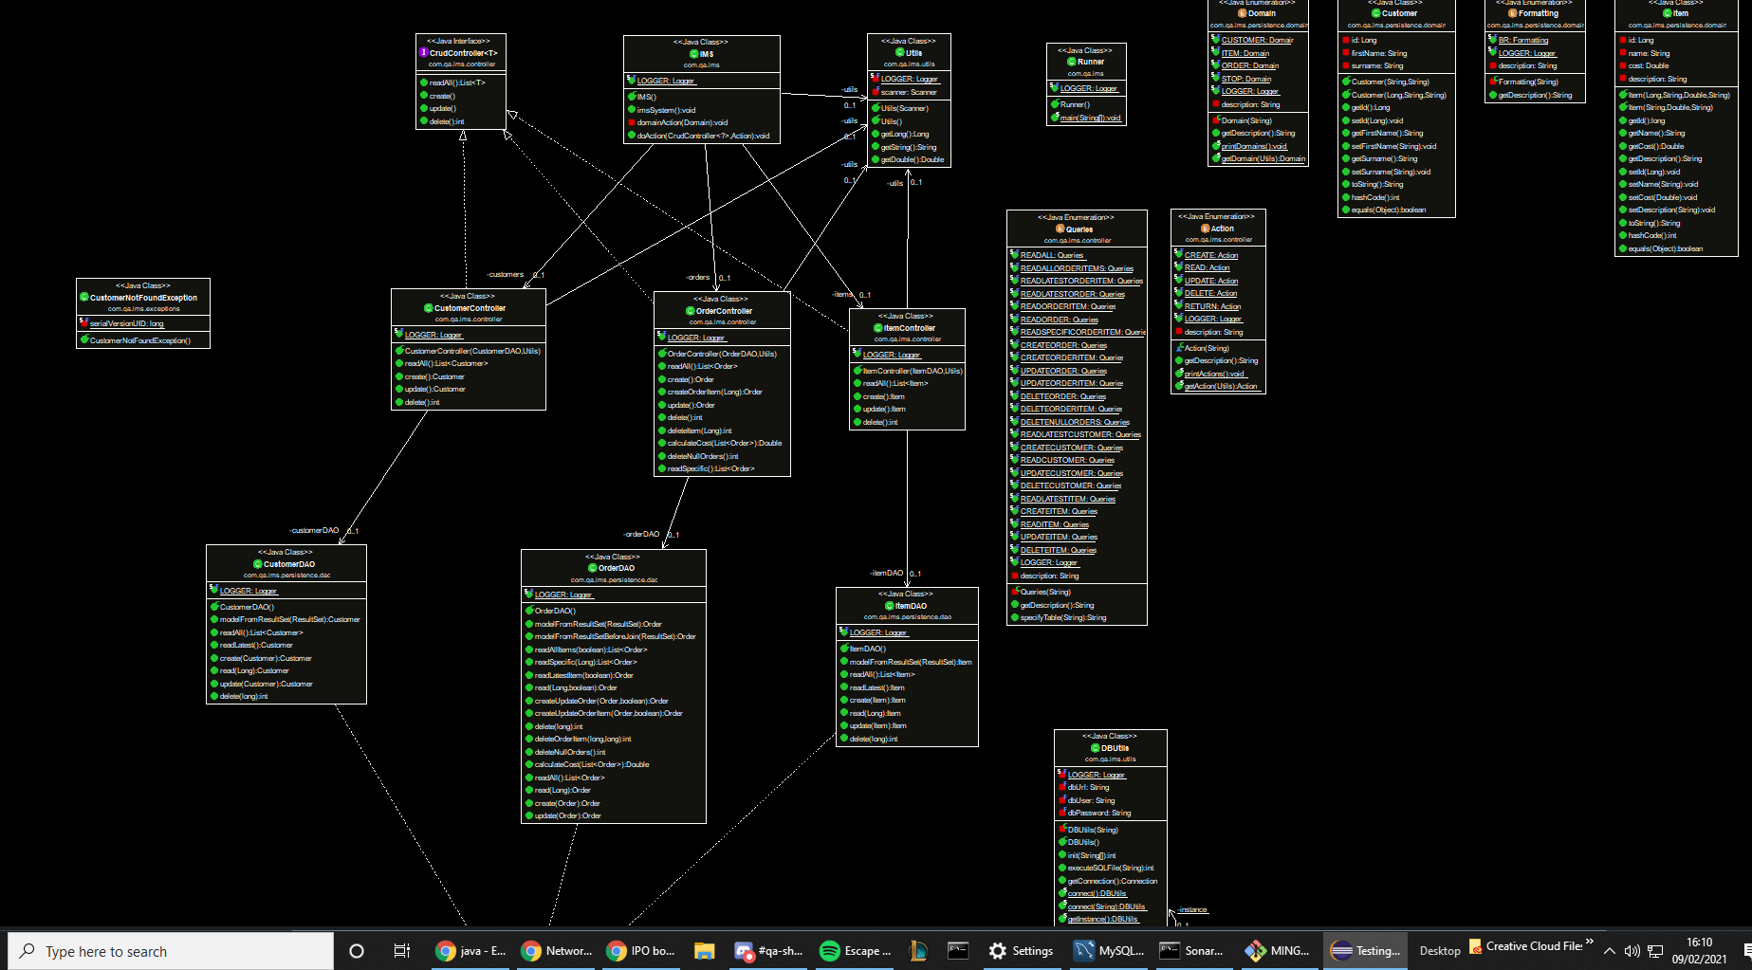
Uml initial
Notes:
This is my initial UML diagram

Slide 27
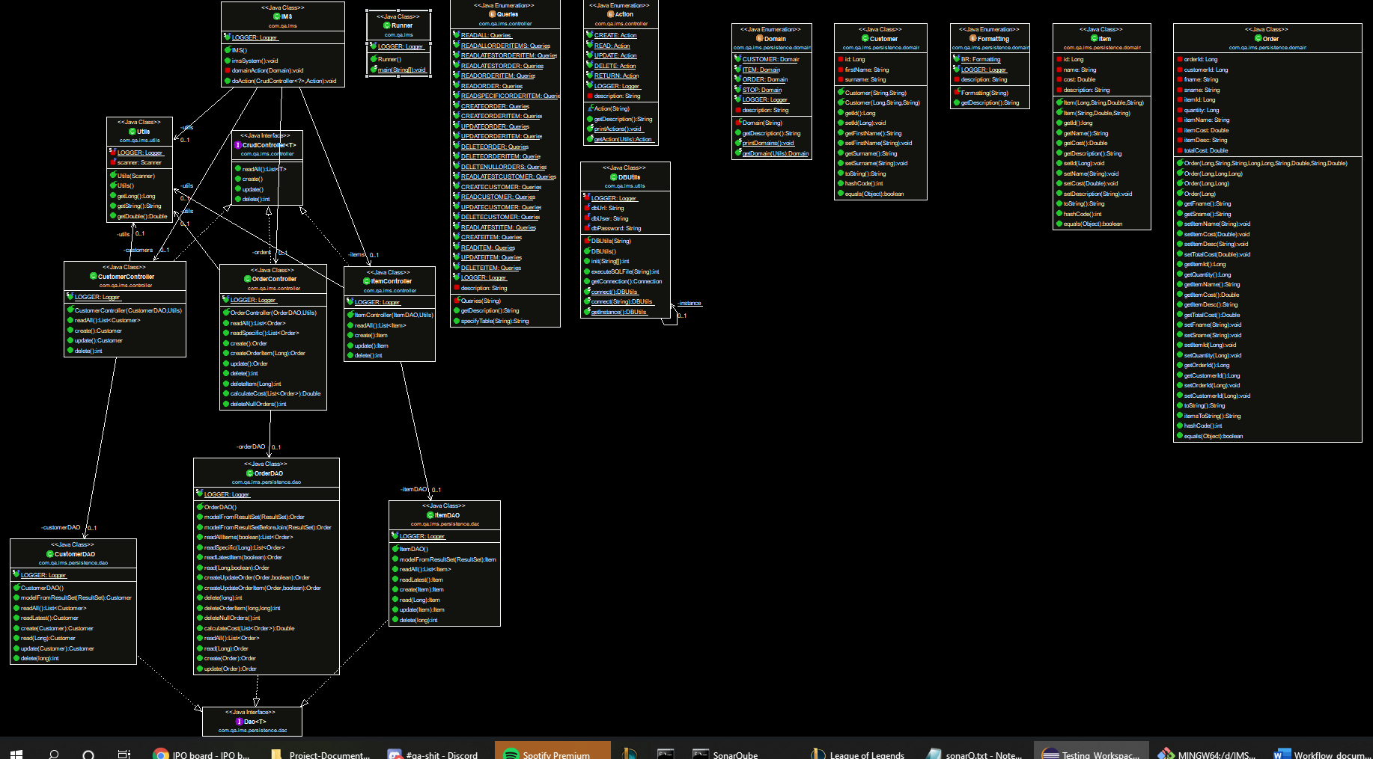
UML revised
Notes:
This is my revised UML diagram

Slide 28
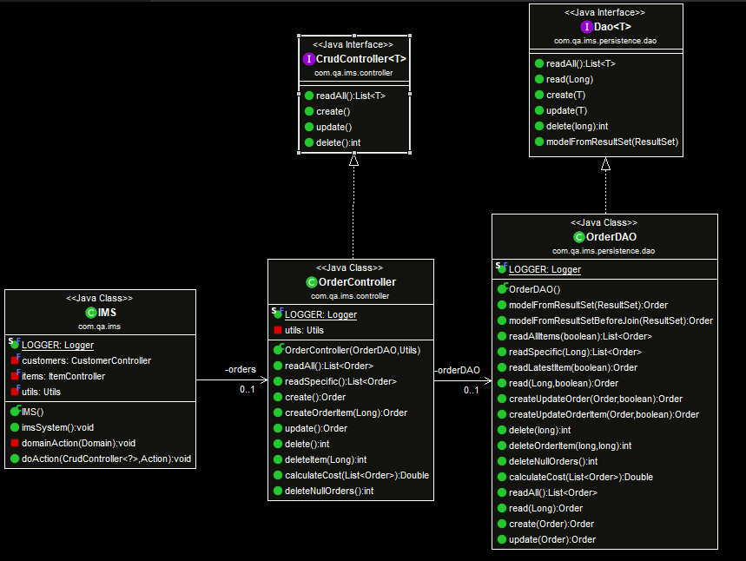
UML TEST CASE
Notes:
This is a test case that shows the relationship between IMS -> OrderController -> OrderDAO
IMS has an association with or uses a OrderController, which has an association with or uses a OrderDAO.

Slide 29
Sprint review
Completed Epics:
Customers
Items
Orders
Order-Items
Testing
To be completed:
- Code Admin
Notes:
There are tasks that I did not have time to accomplish, or that I would continue to work on if I had the time. These are mainly user experience based tasks, that help to increase the readability and efficiency of the program.

Slide 30
Sprint retrospective
What I did well:
Jira – well documented and thought out
GitHub – made consistent commits (smart commits inc.)
Code – efficient, well ordered, good naming conventions
Project Documentation – well detailed, covered all aspects.
What I could have done better:
Jira – better thought out sprints
GitHub – Smart commits from the start.
Code – Better formatted output. More readable error messages (especially SQL errors)

Slide 31
conclusion
I feel that I completed the project to a good standard
There are future implementations that could be added, which would increase the efficiency of the application and the user experience.
I would like to further my knowledge and abilities to use Jira and GitHub properly.
Notes:
I feel that I completed the project to a good standard
There are future implementations that could be added, which would increase the efficiency of the application and the user experience.
I would like to further my knowledge and abilities to use Jira and GitHub properly.

Slide 32
Thanks for watching

